Slide 1
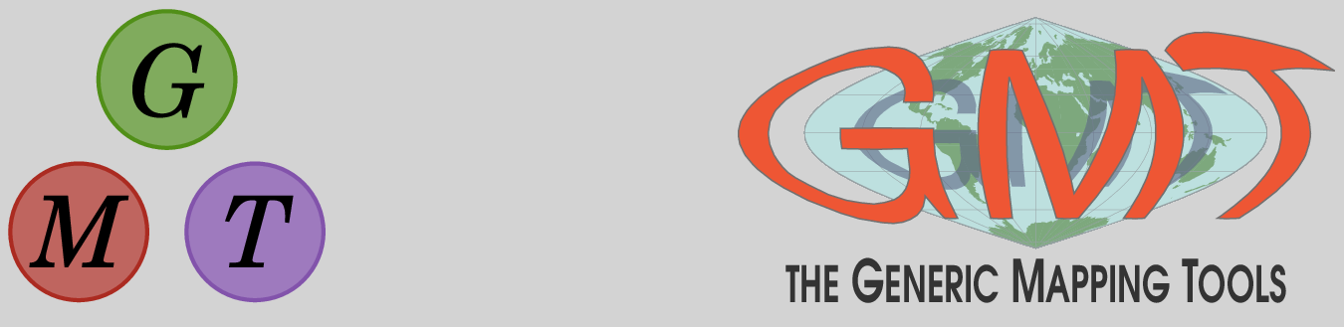
The Generic Mapping Tools (GMT) extended capabilities via the Julia wrapper
Joaquim Luis - University Algarve, IDL, Portugal

Slide 2
GMTMEX – The beginning
At version 6.0, the GMT C Library received a “exchange data via memory locations” mechanism.
All C modules have a #define THIS_MODULE_KEYS with codes that are used to know how to connect the one letter options with data type and direction (In, or Out).
Example codes for grdimage: "<G{+,CC(,IG(,>X},>IA,<ID“
All GMT modules can be run from within MATLAB using a syntax like:
    inside = gmt('gmtselect –F', points, polygon) ;

Slide 3
GMT.jl main goals
Run GMT from a free/open-source and fast scientific computing environment.
Extend GMT beyond its C API
Make GMT easier to learn.
  Replace the cryptic one-char options by human readable commands. The long options
  The previous example now reads:
      D = gmtselect(points, polygon=polygon)

Slide 4
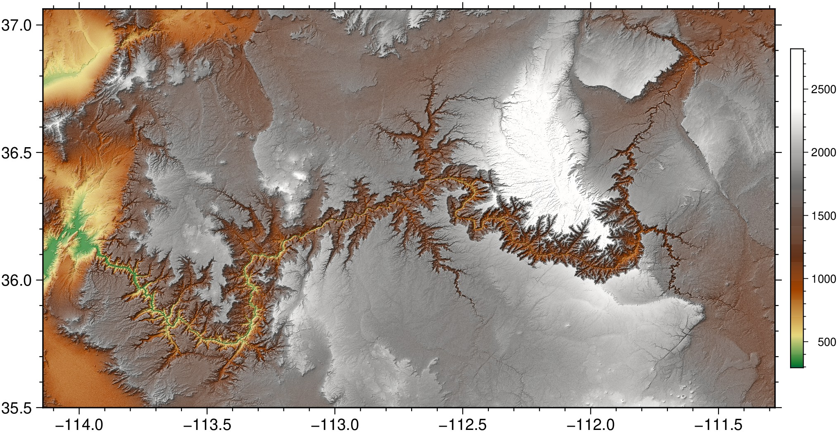
Leland Texture Shading
G = gmtread("@earth_relief_01s_g", region=(-114.14,-111.28,35.50,37.06));
lelandshade(G, color=true, colorbar=true, show=true)

Slide 5
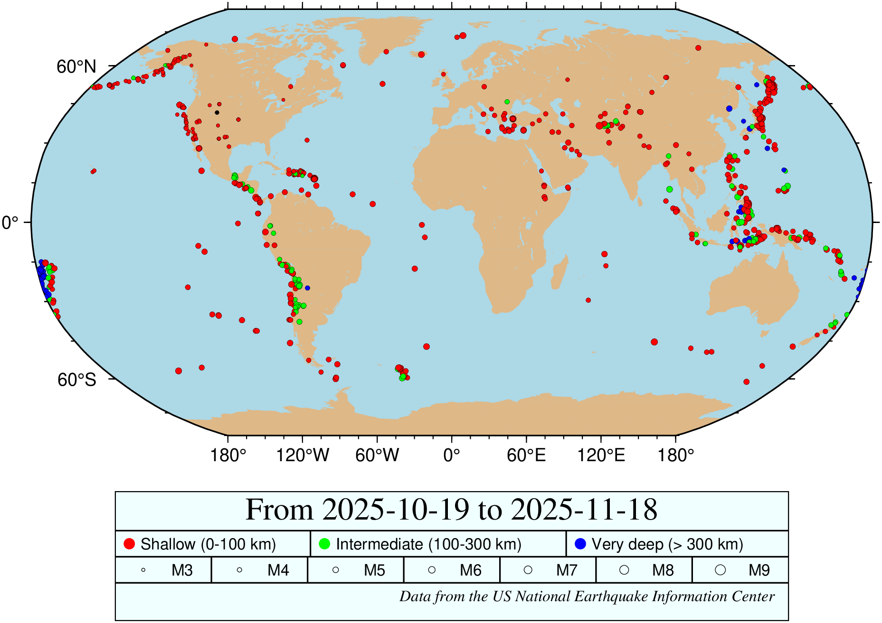
seismicity()

Slide 6
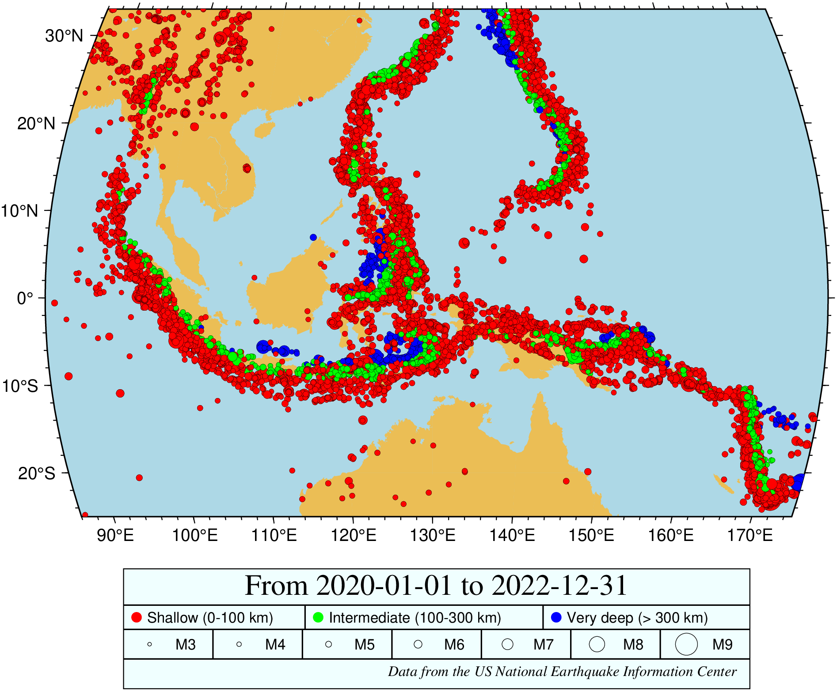
Limit answer in time and region
seismicity(region="86/175/-25/33", size=(exp, [2 12], [3 9]), land=:lightbrown, ocean=:lightblue, starttime="2020-01-01", endtime="2022-12-31")

Slide 7
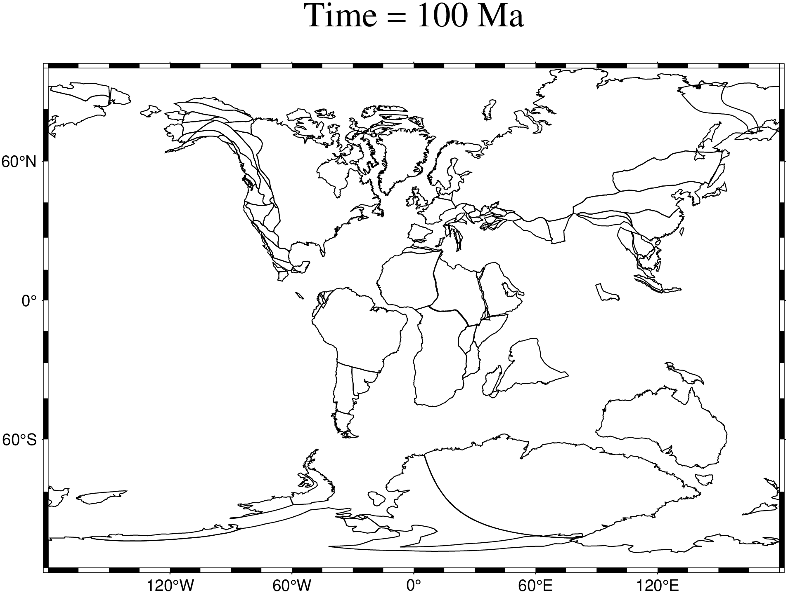
Quick maps from GPLATES data
pastplates()

Slide 8
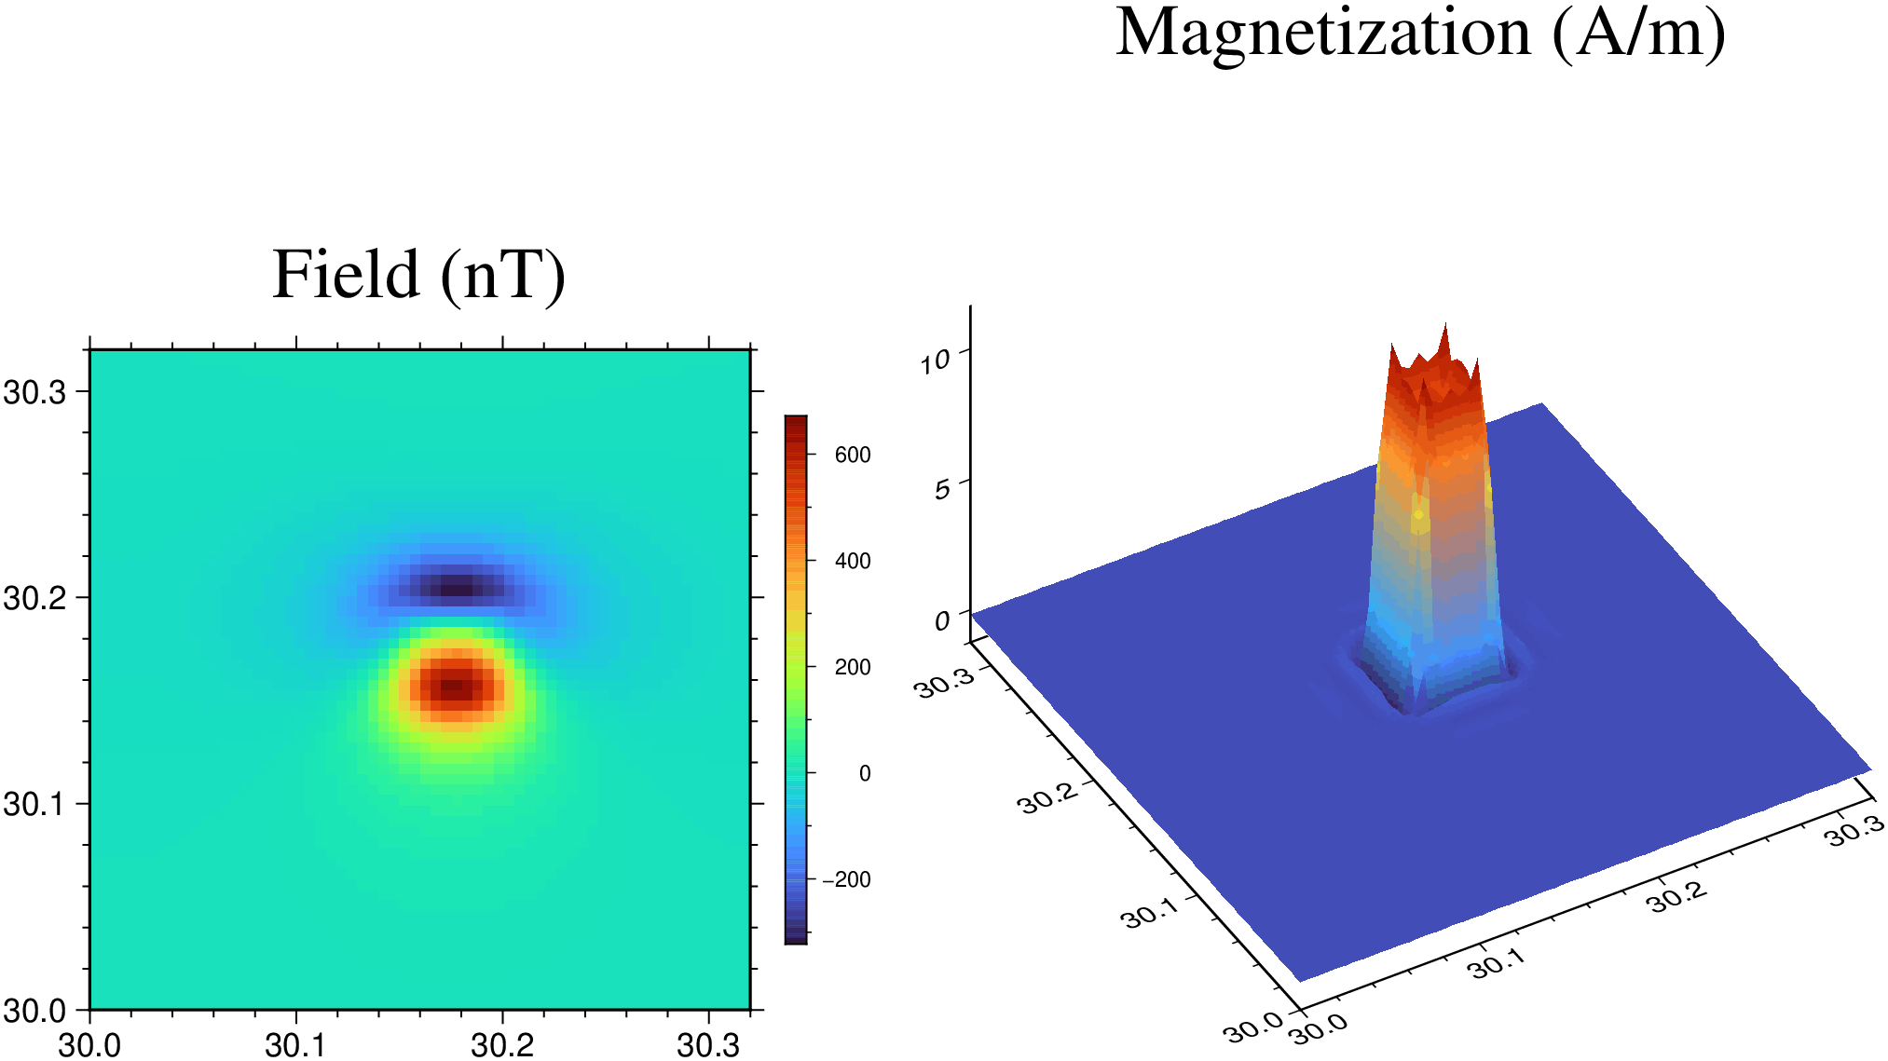
Our Old friend, Parker inversion
A synthetic example of a Kaba like magnetization distribution of 10 A/m

Slide 9
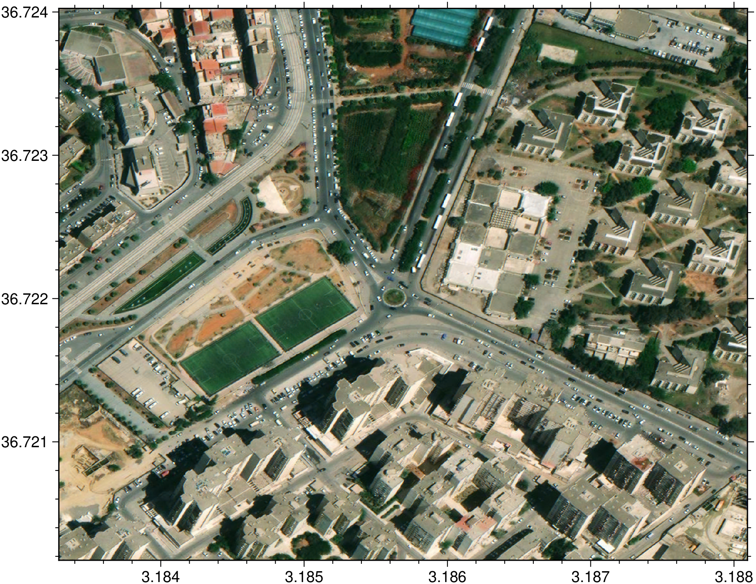
Get georefrenced aereal photos
D = geocoder("BP 32, Bab Ezzouar 16111, Argélia")
I = mosaic(D, zoom=19, neighbors=7)

Slide 10
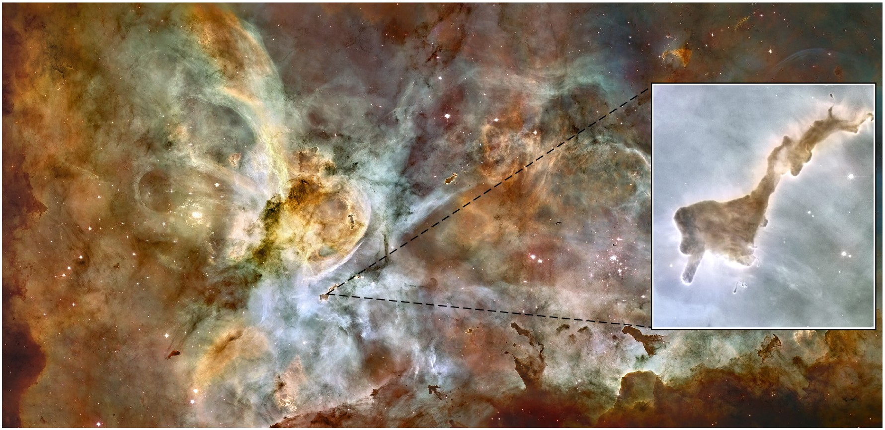
Zoomed insets
im = gmtread("https://wikimedia.org/.../2560px-NGC_3372a-full.jpg");
dedo = gdaltranslate("https://.../NGC_3372a-full.jpg", srcwin=true, limits=(10580, 11360, 9410, 10270));
viz(im, inset=(dedo, pzoom=(945, 390), pos=(anchor=:MR,)))

Slide 11
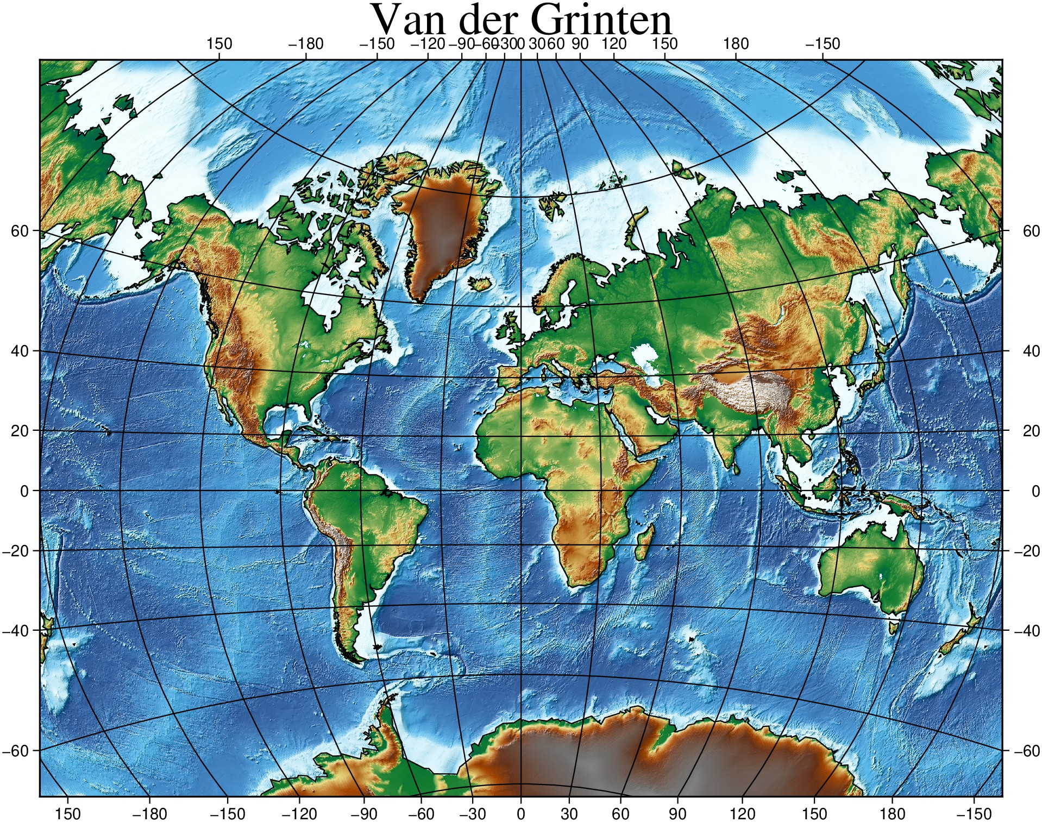
“Best” rectangular World map projection
G, cl = worldrectangular("@earth_relief_06m", proj="vandg", latlim=(-70,85), coast=true);
grid = worldrectgrid(G);
grdimage(G, shade=true, plot=(data=cl,), cmap=:geo, frame=:none, title="Van der Grinten")
plotgrid!(G, grid, name="worldrect.jpg", show=true)

Slide 12
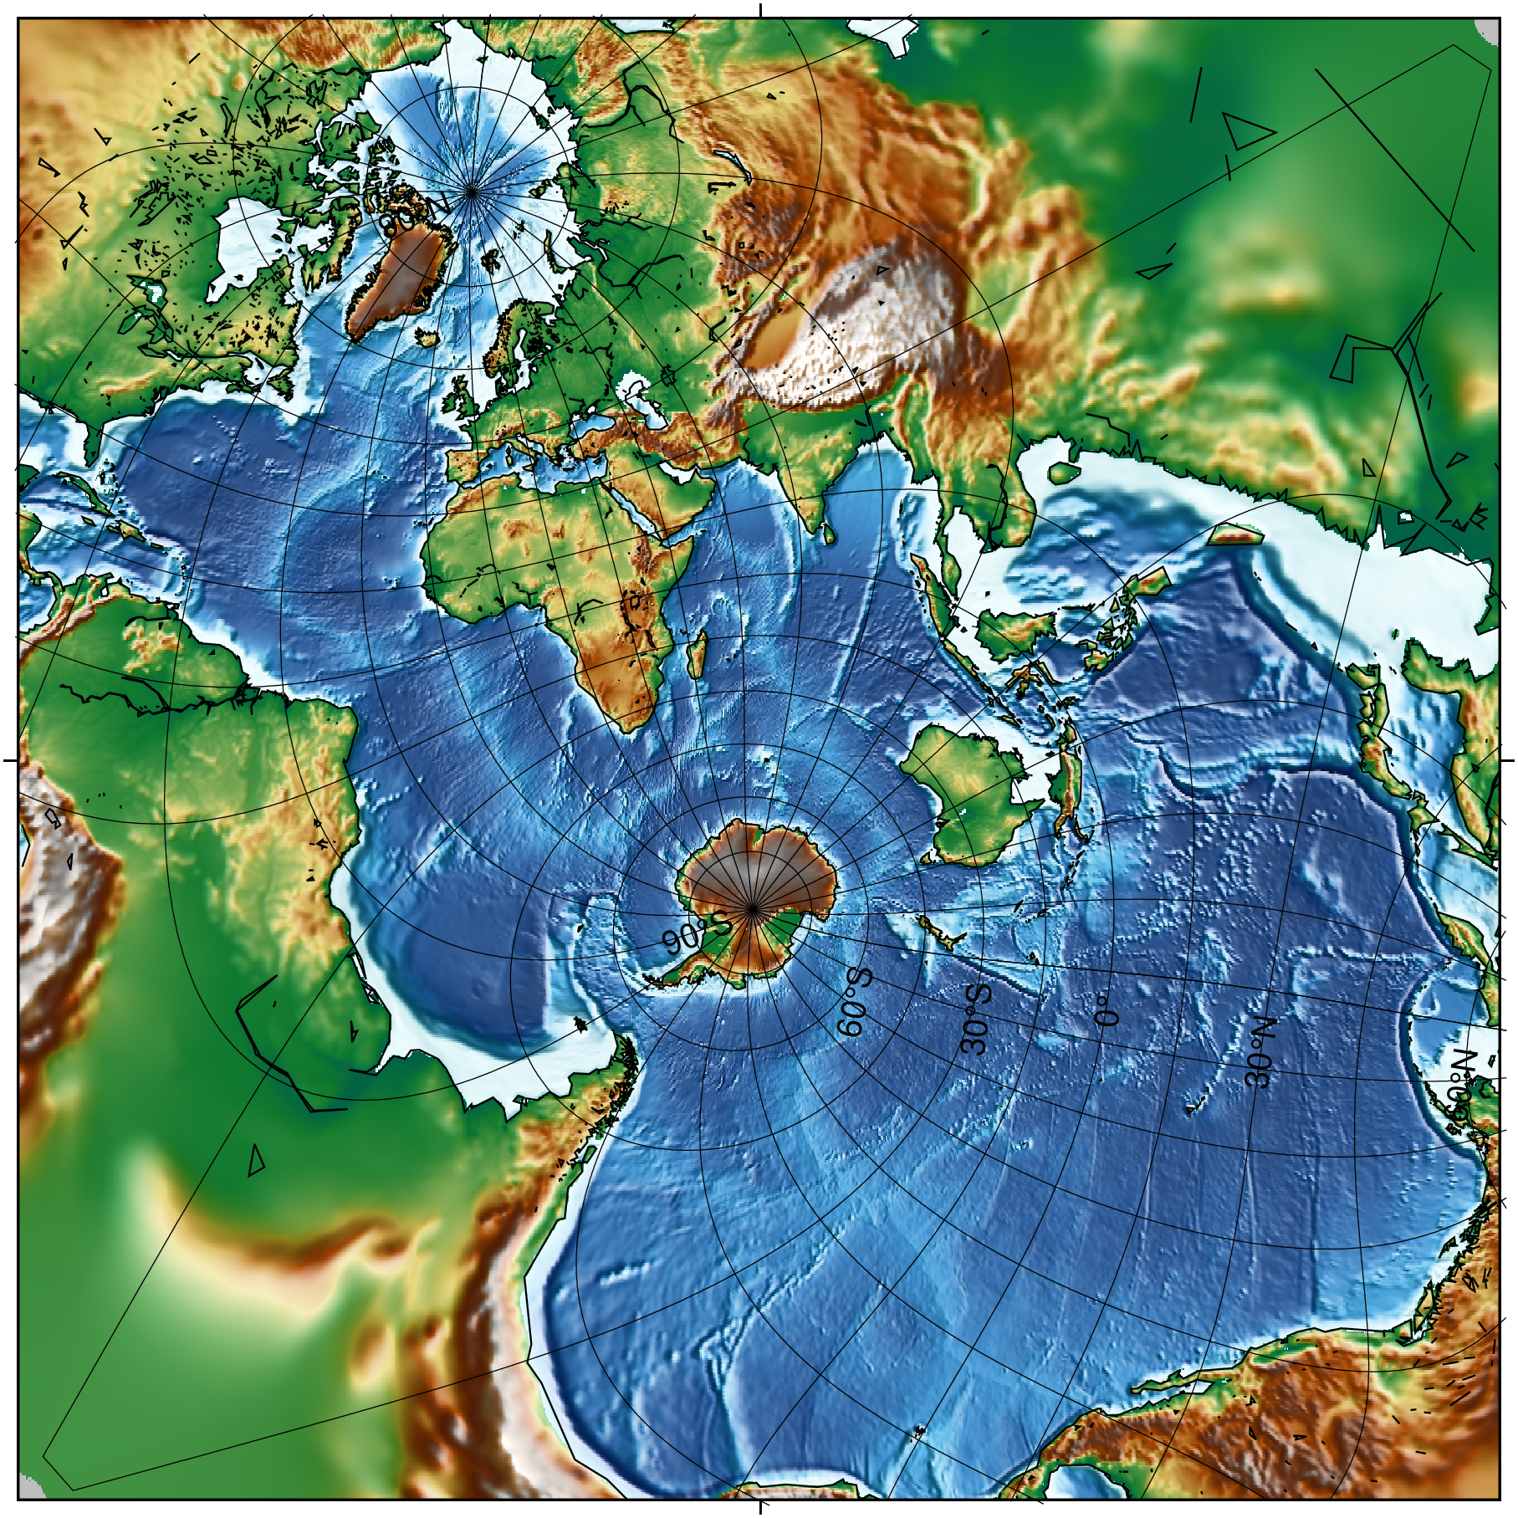
The Spilhaus projection
grdimage("@earth_relief_15m", shade=true, region=global360, proj=“+proj=spilhaus", coast=(shore=true, frame=“Wbet 30g”), show=true);

Slide 13
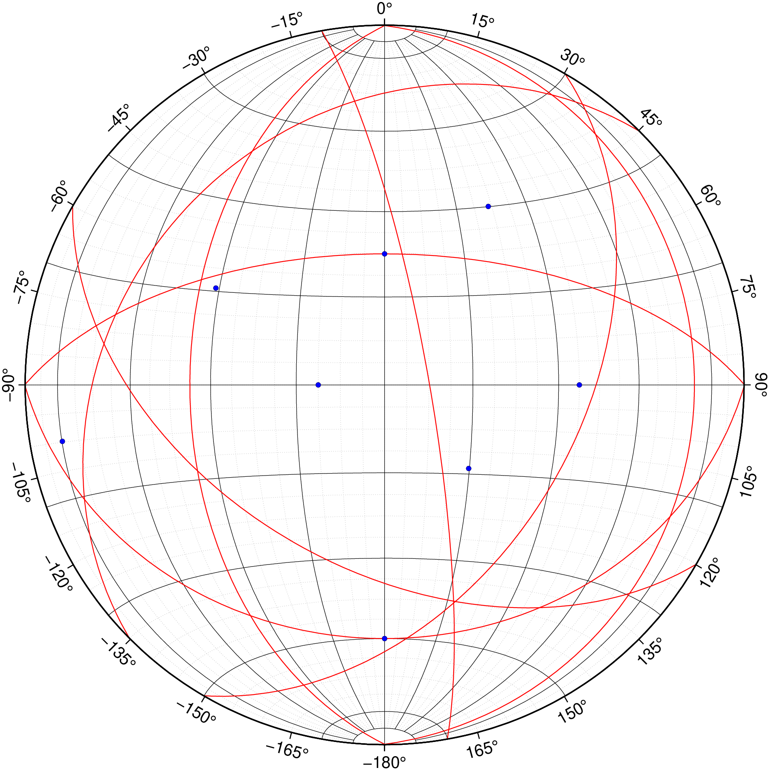
Stereonets
stereonet([90 30; 180 45; 270 60; 0 15; 30 45; 120 48; 225 27; 350 80], show=true)

Slide 14
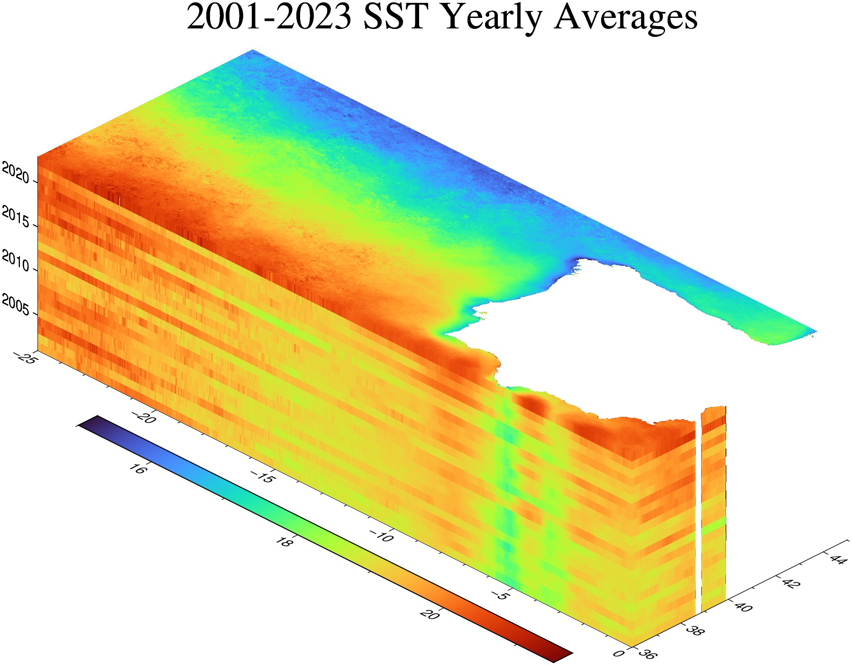
Plotting from data cubes
cube = gmtread("T2001-2023_SST_year_night_filt.nc", layers=:all)
cubeplot(cube, title="2001-2023 SST Yearly Averages", cmap=makecpt(15,21.5), R=(-25,0,35.9612,45), zsize=3, colorbar=true, show=true)

Slide 15
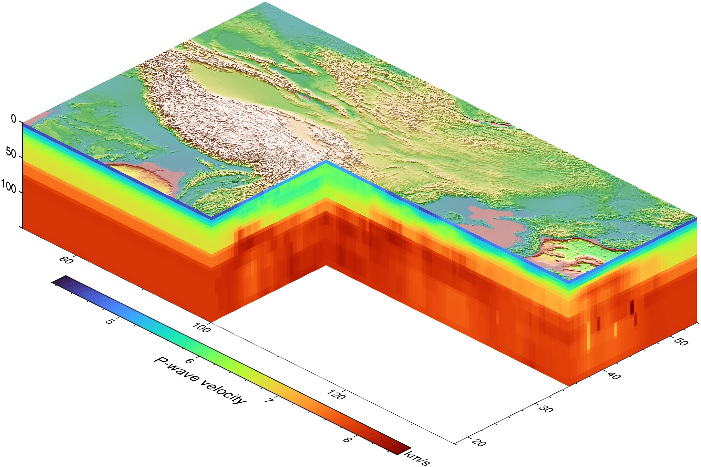
A cubeplot with an inset
model = gmtread("https://github.com/.../USTClitho2.0.wrst.sea_level.txt");
Cvp = xyzw2cube(model);
cubeplot(Cvp, top="@earth_relief", inset=(lon=100, lat=35), zdown=true, zsize=3, colorbar=("xlabel=P-wave velocity", "ylabel=km/s"), show=true)

Slide 16
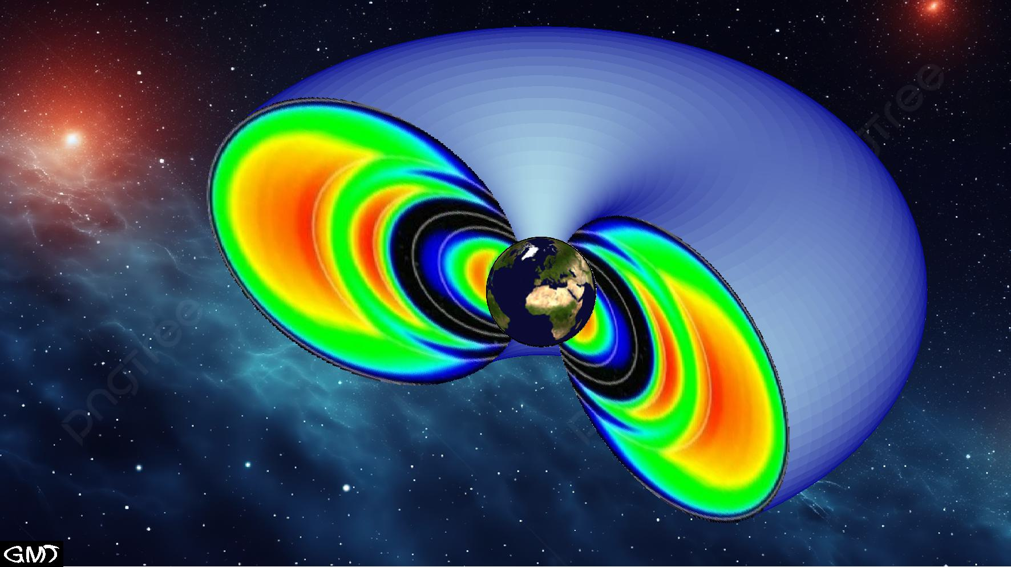
3D meshes
xyz = ellipse3D(center=(1.1,0,0), e=0.5188, plane=:xz, np=72);
FV = revolve(xyz, ang1=0, ang2=200);
FVell = flatfv("vanallen.jpg", shape=xyz);
plot3(FV, view=(130,30), cmap=cpt, frame=:none, pagebg=(image="sunny-milky-way.png", width=0.80, off=(1.0,-1.0), logo=true))
plot3!(FVell)

Slide 17
Helps us develop GMT and its wrappers.
https://forum.generic-mapping-tools.org/
https://github.com/GenericMappingTools/GMT.jl

